Slide 1
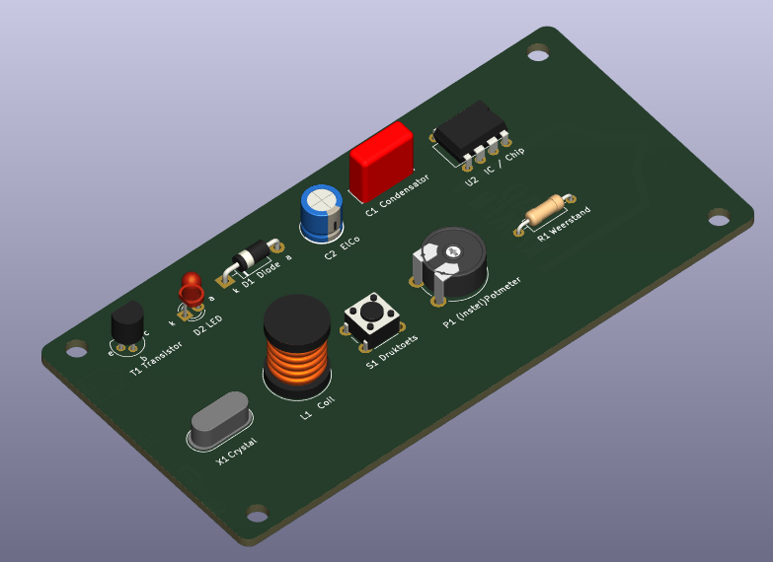

TechDen Zwolle Workshop Elektronica

Slide 2

